Slide 1
Configuration of Neural Networks

Slide 2
Contents
Regression
Binary-Class Classification
Multi-Class Classification
Nominal Input

Slide 3
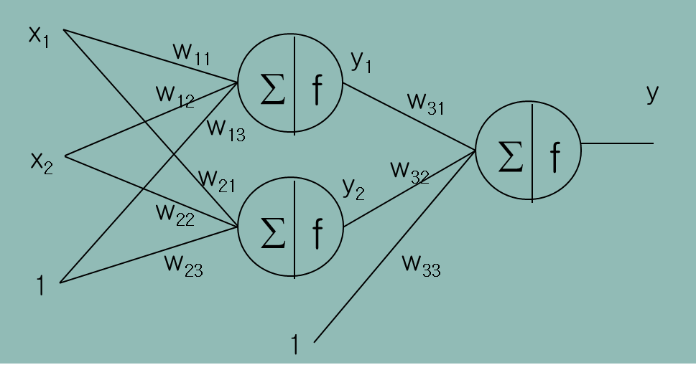
Regression
Following Neural Network is OK for regression?
Maybe NO!! Why?
The activation functions produces a value between [0,1]

Slide 4
Regression
Solution
Normalize the outputs into [0,1]
Or, use a linear output node
x₁
w₁₁
∑
f
w₁₁
y
w₁₂
w₁₃
x₂
∑
w₂₂
w₂₁
w₂₁
∑
f
w₂₃
w₃₁
1
1

Slide 5
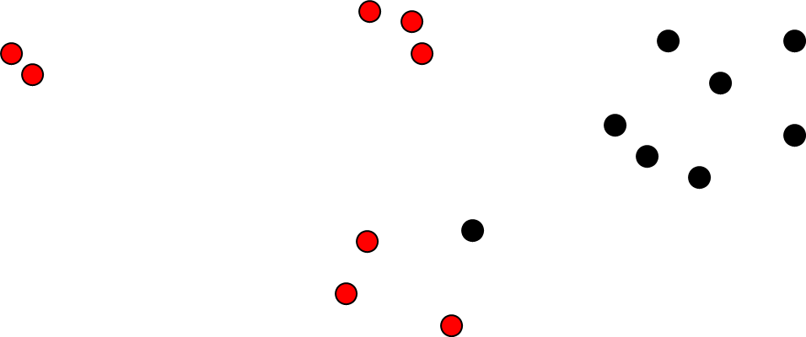
Binary-Class Classification
You Have Two Problems
P1: NN cannot produces nominal values
P2: Error Function for training
$\left(x_{11},x_{12},Red\right)$, $\left(x_{21},x_{22},Red\right)$, $\left(x_{31},x_{32},Black\right),$ $\left(x_{41},x_{42},Red\right),\left(x_{51},x_{52},Black\right),⋯$

Slide 6
Binary-Class Classification
P1: Handling Nominal Values
Use 0 and 1 for class labels
Use Sigmoid
$\left(x_{11},x_{12},Red\right)$, $\left(x_{21},x_{22},Red\right)$, $\left(x_{31},x_{32},Black\right),$ $\left(x_{41},x_{42},Red\right),\left(x_{51},x_{52},Black\right),⋯$
$\left(x_{11},x_{12},1\right)$, $\left(x_{21},x_{22},1\right)$, $\left(x_{31},x_{32},0\right),$ $\left(x_{41},x_{42},1\right),\left(x_{51},x_{52},0\right),⋯$

Slide 7
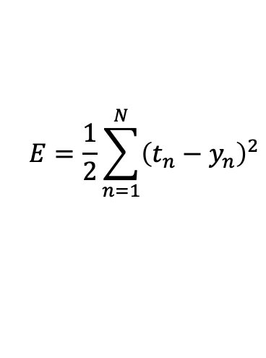
Binary-Class Classification
P2: Error Function for Training
Sigmoid at output node
+
MSE
$$E=\frac{1}{2}\sum_{n=1}^{N}{{\left(t_{n}−y_{n}\right)}^{2}}$$
NNs will not be trained in some special cases!!

Slide 8
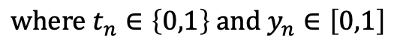
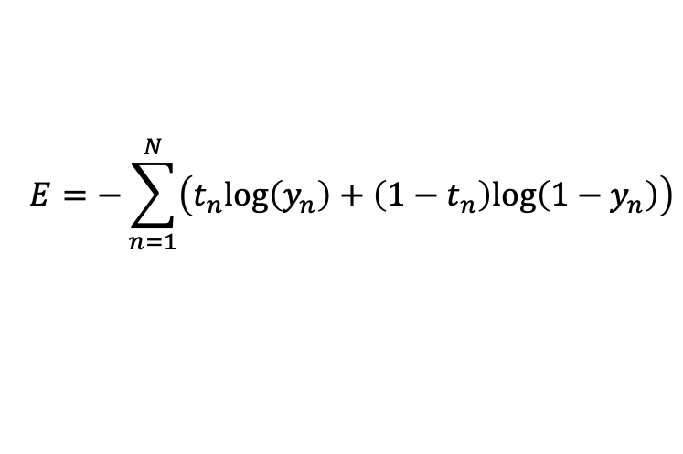
Binary-Class Classification
P2: Error Function for Training
$\left(x_{11},x_{12},1\right)$, $\left(x_{21},x_{22},1\right)$, $\left(x_{31},x_{32},0\right),$ $\left(x_{41},x_{42},1\right),\left(x_{51},x_{52},0\right),⋯$
Sigmoid at output node
+
Cross Entropy
$$E=−\sum_{n=1}^{N}{\left(t_{n}log\left(y_{n}\right)+\left(1−t_{n}\right)log\left(1−y_{n}\right)\right)}$$
$$where{ t}_{n}∈\left\{0,1\right\} and{ y}_{n}∈\left[0,1\right]$$

Slide 9
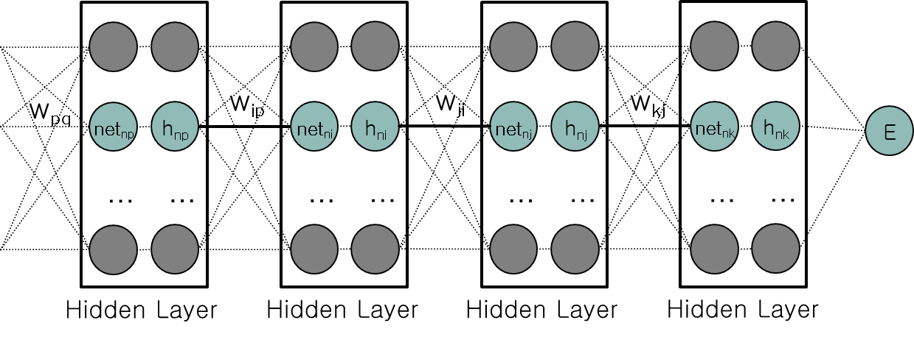
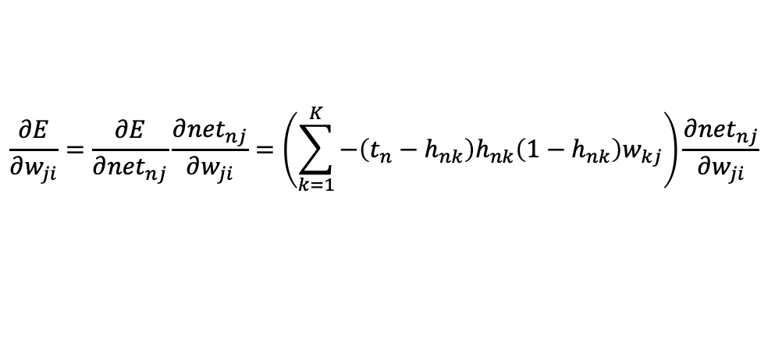
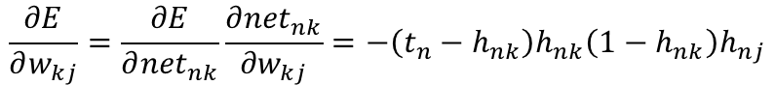
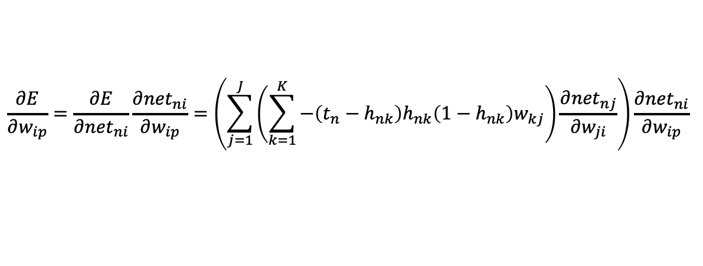
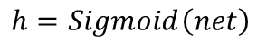
Binary-Class Classification
Reminding: Weights between deep layers
$$\frac{∂E}{∂w_{kj}}=\frac{∂E}{∂{net}_{nk}}\frac{∂{net}_{nk}}{∂w_{kj}}=−\left(t_{n}−h_{nk}\right)h_{nk}\left(1−h_{nk}\right)h_{nj}$$
If
$$h=Sigmoid\left(net\right)$$
$$\frac{∂E}{∂w_{ji}}=\frac{∂E}{∂{net}_{nj}}\frac{∂{net}_{nj}}{∂w_{ji}}=\left(\sum_{k=1}^{K}{−\left(t_{n}−h_{nk}\right)h_{nk}\left(1−h_{nk}\right)w_{kj}}\right)\frac{∂{net}_{nj}}{∂w_{ji}}$$
$$\frac{∂E}{∂w_{ip}}=\frac{∂E}{∂{net}_{ni}}\frac{∂{net}_{ni}}{∂w_{ip}}=\left(\sum_{j=1}^{J}{\left(\sum_{k=1}^{K}{−\left(t_{n}−h_{nk}\right)h_{nk}\left(1−h_{nk}\right)w_{kj}}\right)\frac{∂{net}_{nj}}{∂w_{ji}}}\right)\frac{∂{net}_{ni}}{∂w_{ip}}$$

Slide 10
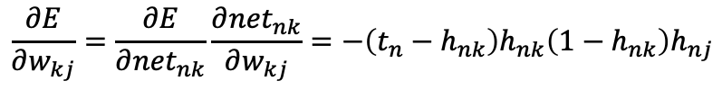
Binary-Class Classification
Not Good…
If h_{nk} is close to 1 or 0, all gradients for n-th training data is 0
What if h_{nk} is close to 1 or 0 but it’s wrong?
If most of data are mis-learned,
NN cannot escape from the mis-learning
$$\frac{∂E}{∂w_{kj}}=\frac{∂E}{∂{net}_{nk}}\frac{∂{net}_{nk}}{∂w_{kj}}=−\left(t_{n}−h_{nk}\right)h_{nk}\left(1−h_{nk}\right)h_{nj}$$
If
$$h=Sigmoid\left(net\right)$$
$$\frac{∂E}{∂w_{ji}}=\frac{∂E}{∂{net}_{nj}}\frac{∂{net}_{nj}}{∂w_{ji}}=\left(\sum_{k=1}^{K}{−\left(t_{n}−h_{nk}\right)h_{nk}\left(1−h_{nk}\right)w_{kj}}\right)\frac{∂{net}_{nj}}{∂w_{ji}}$$
$$\frac{∂E}{∂w_{ip}}=\frac{∂E}{∂{net}_{ni}}\frac{∂{net}_{ni}}{∂w_{ip}}=\left(\sum_{j=1}^{J}{\left(\sum_{k=1}^{K}{−\left(t_{n}−h_{nk}\right)h_{nk}\left(1−h_{nk}\right)w_{kj}}\right)\frac{∂{net}_{nj}}{∂w_{ji}}}\right)\frac{∂{net}_{ni}}{∂w_{ip}}$$

Slide 11
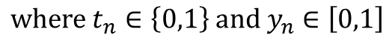
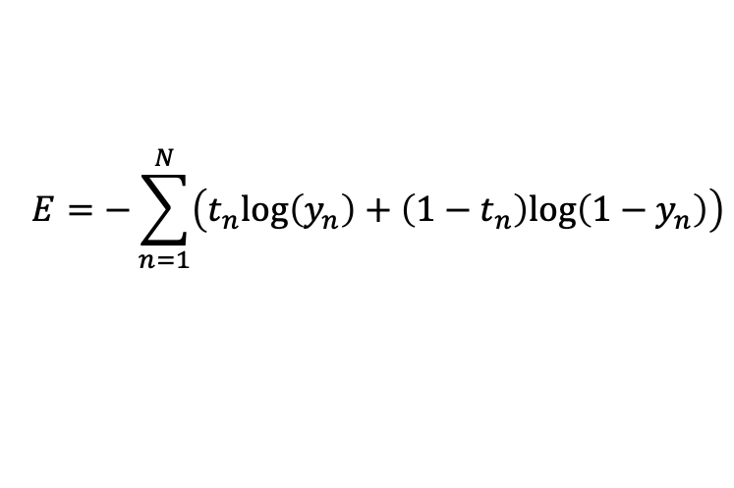
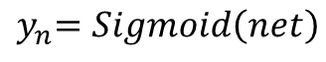
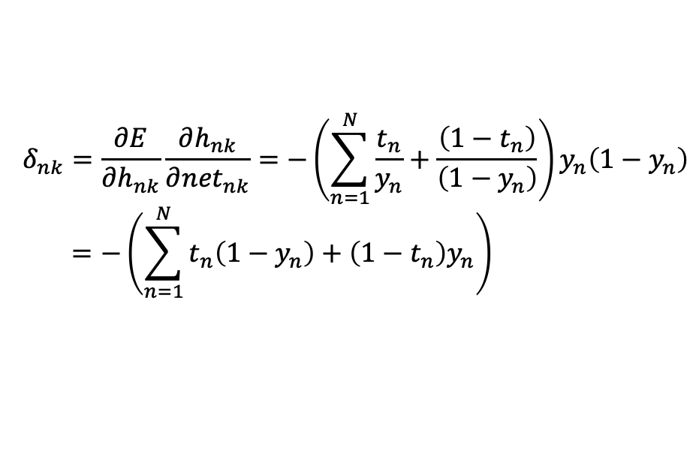
Binary-Class Classification
Cross Entropy
$$E=−\sum_{n=1}^{N}{\left(t_{n}log\left(y_{n}\right)+\left(1−t_{n}\right)log\left(1−y_{n}\right)\right)}$$
$$where{ t}_{n}∈\left\{0,1\right\} and{ y}_{n}∈\left[0,1\right]$$
$${ y}_{n}=Sigmoid\left(net\right)$$
$$δ_{nk}=\frac{∂E}{∂h_{nk}}\frac{∂h_{nk}}{∂{net}_{nk}}=−\left(\sum_{n=1}^{N}{\frac{t_{n}}{y_{n}}+\frac{\left(1−t_{n}\right)}{\left(1−y_{n}\right)}}\right)y_{n}\left(1−y_{n}\right)$$
$$=−\left(\sum_{n=1}^{N}{t_{n}\left(1−y_{n}\right)+\left(1−t_{n}\right)y_{n}}\right)$$

Slide 12
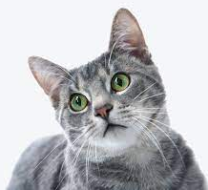
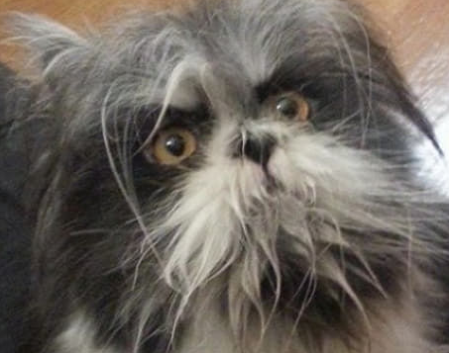

Binary-Class Classification
What Cross Entropy Is ?
Training Data
Test Data
, 0
NN
0.7
, 1
…
I call this “Label”, then How can we interpret this?

Slide 13
Binary-Class Classification
What Cross Entropy Is ?
Training Data
Test Data
, 0
NN
0.7
, 1
…
Let’s regard this as “Probability of Dog”, then it is easy to interpret

Slide 14
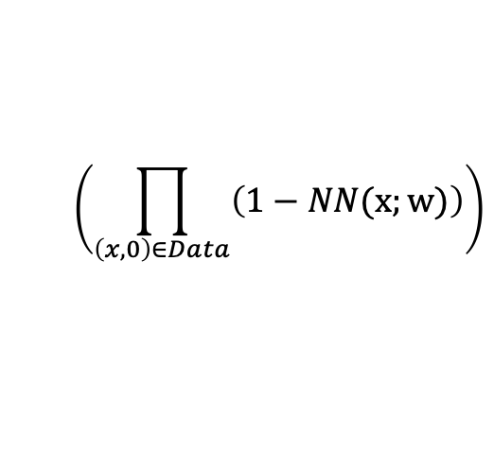
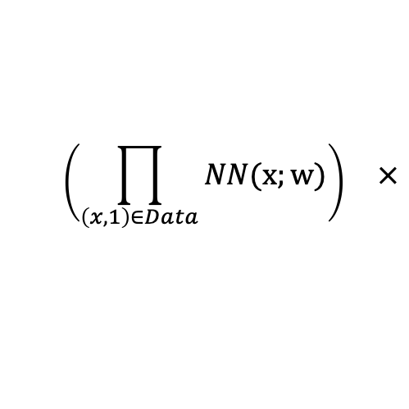
Binary-Class Classification
What Cross Entropy Is?
Output of Classification -> Probability
Find w so that NN correctly predicts all training data
Find w which maximizes the probability that
NN correctly predicts all training data
Find w which maximizes the following:
$$\left(\prod_{\left(x, 1\right)∈Data}{NN(x;w)}\right) ×$$
$$\left(\prod_{\left(x, 0\right)∈Data}{\left(1−NN(x;w)\right)}\right)$$
Probability to be DOG
Probability to be CAT

Slide 15
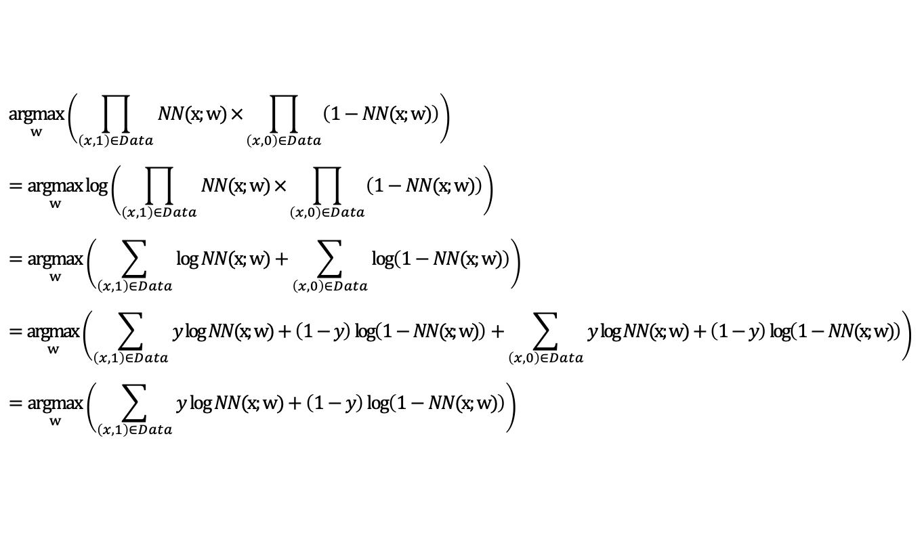
Binary-Class Classification
Cross Entropy
$$\underset{w}{argmax}\left(\prod_{\left(x, 1\right)∈Data}{NN(x;w)}×\prod_{\left(x, 0\right)∈Data}{\left(1−NN(x;w)\right)}\right)$$
$$=\underset{w}{argmax}{\log\left(\prod_{\left(x, 1\right)∈Data}{NN(x;w)}×\prod_{\left(x, 0\right)∈Data}{\left(1−NN(x;w)\right)}\right)}$$
$$=\underset{w}{argmax}\left(\sum_{\left(x, 1\right)∈Data}{\log{NN(x;w)}}+\sum_{\left(x, 0\right)∈Data}{\log\left(1−NN(x;w)\right)}\right)$$
$$=\underset{w}{argmax}\left(\sum_{\left(x, 1\right)∈Data}{y\log{NN(x;w)}+\left(1−y\right)\log\left(1−NN(x;w)\right)}+\sum_{\left(x, 0\right)∈Data}{y\log{NN(x;w)}+\left(1−y\right)\log\left(1−NN(x;w)\right)}\right)$$
$$=\underset{w}{argmax}\left(\sum_{\left(x, 1\right)∈Data}{y\log{NN(x;w)}+\left(1−y\right)\log\left(1−NN(x;w)\right)}\right)$$

Slide 16
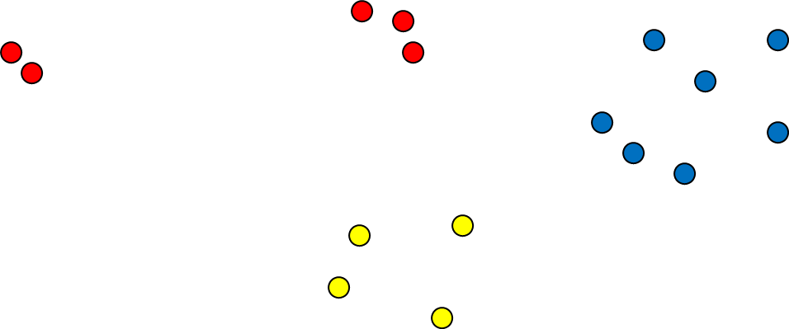
Multi-Class Classification
Problem
Easy...
$\left(x_{1},Red\right)$, $\left(x_{2},Yellow\right)$, $\left(x_{3},Blue\right),$ $\left(x_{4},Red\right),\left(x_{5},Blue\right),⋯$

Slide 17
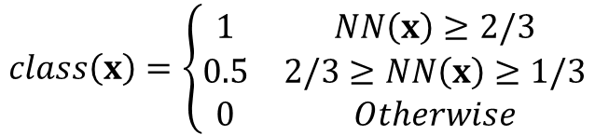
Multi-Class Classification
Nominal Value Handling: Linear conversion of class labels
Use Sigmoid at output node
Prediction
$\left(x_{11},x_{12},Red\right)$, $\left(x_{21},x_{22},Yellow\right)$, $\left(x_{31},x_{32},Blue\right),$ $\left(x_{41},x_{42},Red\right),\left(x_{51},x_{52},Blue\right),⋯$
$\left(x_{11},x_{12},1\right)$, $\left(x_{21},x_{22},0.5\right)$, $\left(x_{31},x_{32},0\right),$ $\left(x_{41},x_{42},1\right),\left(x_{51},x_{52},0\right),⋯$
$$class\left(x\right)=\left\{\begin{matrix}1 & NN\left(x\right)≥2/3 \\ 0.5 & 2/3≥NN\left(x\right)≥1/3 \\ 0 & Otherwise\end{matrix}\right.$$

Slide 18
Multi-Class Classification
Not Good… why?
There is no order between Red, Yellow, Blue
They are just names. We cannot say that Red > Yellow > Blue
Linear conversion changes the original problem.
Red
Yellow
Blue
1.0
0.5
0.0

Slide 19
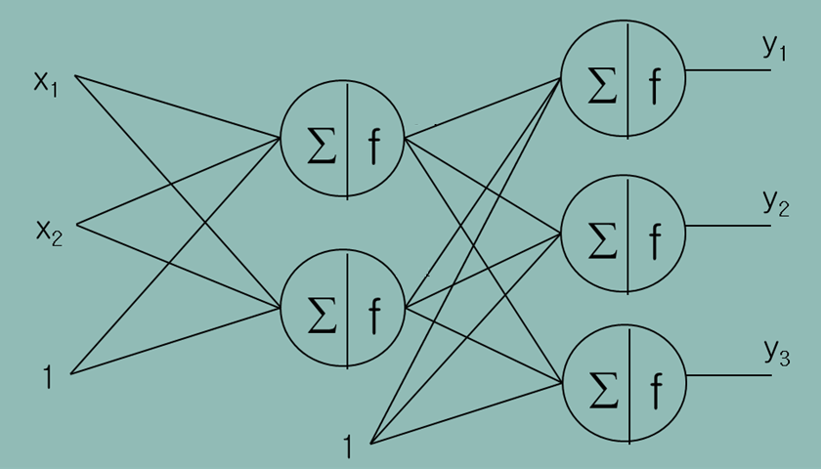
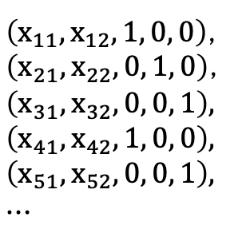
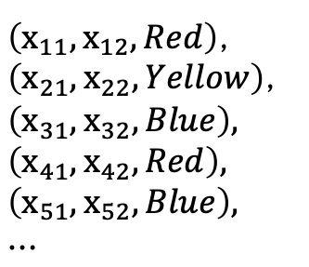
Multi-Class Classification
Then?
Create virtual outputs
Place nodes at the output layer as many as virtual outputs
$\left(x_{11},x_{12},Red\right)$,
$\left(x_{21},x_{22},Yellow\right)$,
$\left(x_{31},x_{32},Blue\right),$
$$\left(x_{41},x_{42},Red\right),$$
$$\left(x_{51},x_{52},Blue\right),$$
$$⋯$$
$\left(x_{11},x_{12},1, 0, 0\right)$,
$\left(x_{21},x_{22},0, 1, 0\right)$,
$\left(x_{31},x_{32},0, 0, 1\right),$
$$\left(x_{41},x_{42},1, 0, 0\right),$$
$$\left(x_{51},x_{52},0, 0, 1\right),$$
$$⋯$$

Slide 20
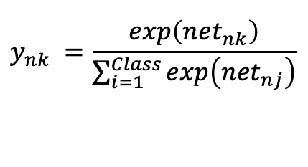
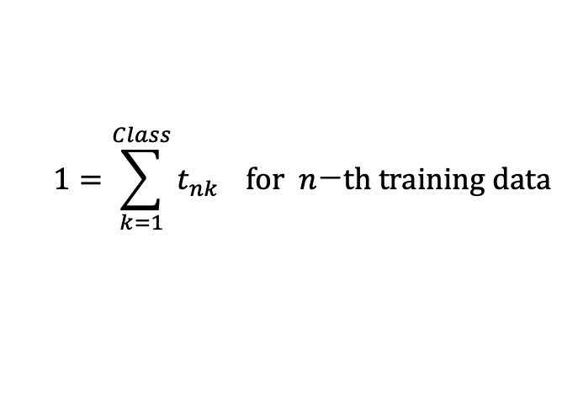
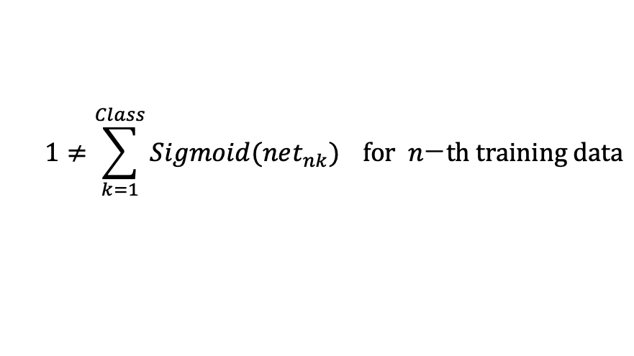
Multi-Class Classification
How about Activation Function?
Outputs of Multi-Class Classification satisfies
But, Sigmoid does not satisfy this (Not a Probability)
So, we use Softmax layer
$$1=\sum_{k=1}^{Class}{t_{nk}} for n\text{−}th training data$$
$$1≠\sum_{k=1}^{Class}{Sigmoid(net_{nk})} for n\text{−}th training data$$
$$y_{nk} =\frac{exp\left({net}_{nk}\right)}{\sum_{i=1}^{Class}{exp\left({net}_{nj}\right)}}$$

Slide 21
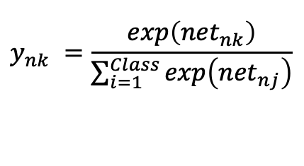
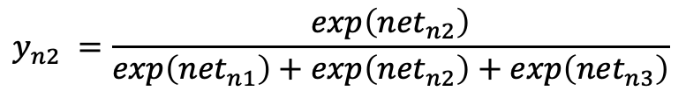
Multi-Class Classification
Softmax layer
Regular layer
Softmax layer
$$y_{nk} =\frac{exp\left({net}_{nk}\right)}{\sum_{i=1}^{Class}{exp\left({net}_{nj}\right)}}$$
$$y_{n2} =\frac{exp\left({net}_{n2}\right)}{exp\left({net}_{n1}\right)+exp\left({net}_{n2}\right)+exp\left({net}_{n3}\right)}$$

Slide 22
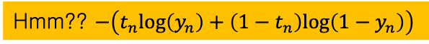
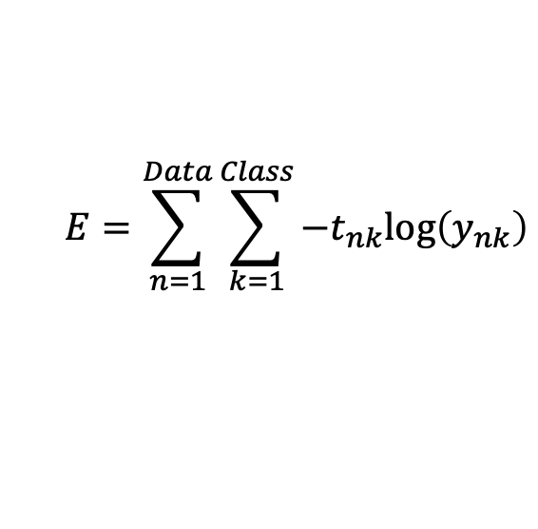
Multi-Class Classification
Loss Function
$$E=\sum_{n=1}^{Data}{\sum_{k=1}^{Class}{−t_{nk}log\left(y_{nk}\right)}}$$
Hmm?? $−\left(t_{n}log\left(y_{n}\right)+\left(1−t_{n}\right)log\left(1−y_{n}\right)\right)$

Slide 23
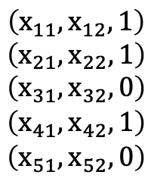
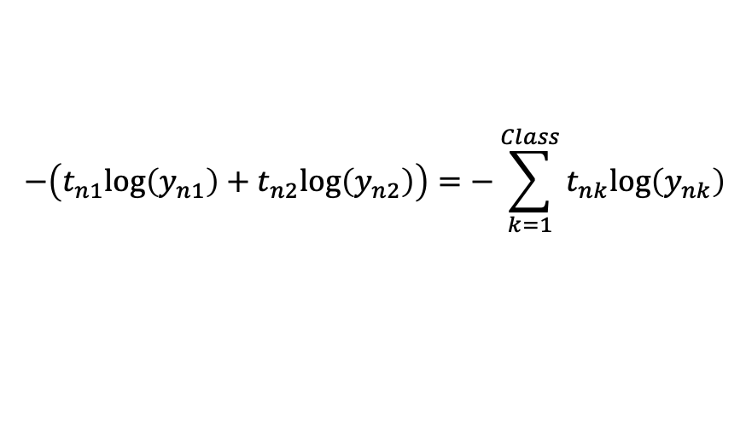
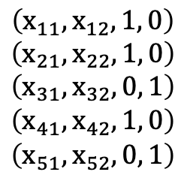
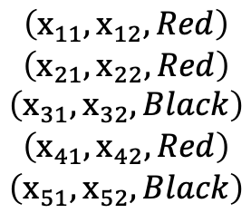
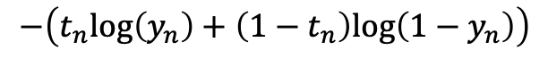
Multi-Class Classification
Cross Entropy for Multi-Class
$$\left(x_{11},x_{12},Red\right)$$
$$\left(x_{21},x_{22},Red\right)$$
$$\left(x_{31},x_{32},Black\right)$$
$$\left(x_{41},x_{42},Red\right)$$
$$\left(x_{51},x_{52},Black\right)$$
$$\left(x_{11},x_{12},1\right)$$
$$\left(x_{21},x_{22},1\right)$$
$$\left(x_{31},x_{32},0\right)$$
$$\left(x_{41},x_{42},1\right) \\ \left(x_{51},x_{52},0\right)$$
$$\left(x_{11},x_{12},1, 0\right)$$
$$\left(x_{21},x_{22},1, 0\right)$$
$$\left(x_{31},x_{32},0, 1\right)$$
$$\left(x_{41},x_{42},1, 0\right) \\ \left(x_{51},x_{52},0, 1\right)$$
$$−\left(t_{n1}log\left(y_{n1}\right)+t_{n2}log\left(y_{n2}\right)\right)=−\sum_{k=1}^{Class}{t_{nk}log\left(y_{nk}\right)}$$
$$−\left(t_{n}log\left(y_{n}\right)+\left(1−t_{n}\right)log\left(1−y_{n}\right)\right)$$

Slide 24
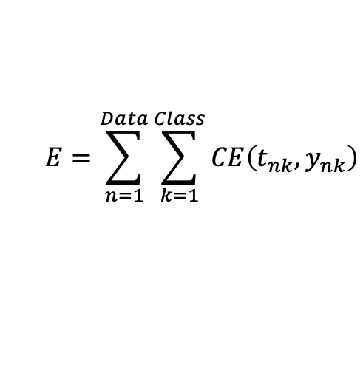
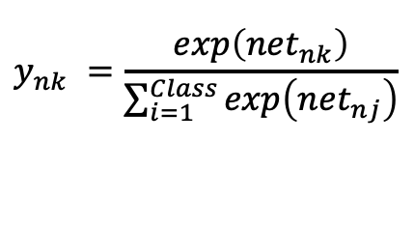
Multi-Class Classification
How about Error Function?
Softmax layer + Cross Entropy
$$E=\sum_{n=1}^{Data}{\sum_{k=1}^{Class}{CE\left(t_{nk},y_{nk}\right)}}$$
$$y_{nk} =\frac{exp\left({net}_{nk}\right)}{\sum_{i=1}^{Class}{exp\left({net}_{nj}\right)}}$$
Softmax layer

Slide 25
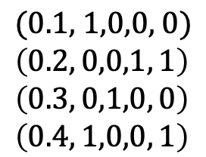
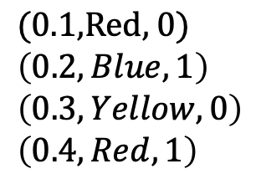
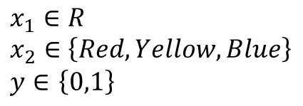
Nominal Inputs
What if you have categorical inputs
Two inputs and one output
Create a new input variable for each categorical value
$$x_{1}∈R$$
$$x_{2}∈\left\{Red, Yellow, Blue\right\}$$
$y∈$ $\left\{0,1\right\}$
$$\text{(0.1,}\text{Red}\text{, 0)}$$
$$\left(0.2,Blue, 1\right)$$
$$\left(0.3,Yellow, 0\right)$$
$$\left(0.4,Red, 1\right)$$
$$\text{(0.1, 1,0,0, 0)}$$
$$\left(0.2, 0,0,1, 1\right)$$
$$\left(0.3, 0,1,0, 0\right)$$
$$\left(0.4, 1,0,0, 1\right)$$

Slide 26
Summary
Problem | Activation Function |  | Loss function
 | Hidden Layer | Output Layer
Regression | ReLU | Linear | MSE
2-class Classification | ReLU | Sigmoid | CE
Multi-class Classification | ReLU | Softmax layer | CE

